Slide 1
Amazon Stock Price Prediction Using Machine Learning Techniques CS5841- Machine Learning Group 15 - Final Project 2021
Members names: Submitted to:
Navjot Kaur Prof. Xiaoyong (Brian) Yuan
Prathamesh Jadhav
Surya Ravula

Slide 2
BACKGROUND OF AMAZON STOCK
Amazon.com is a leading player in the market in online retail services. It operates through the following business segments: North America, International, and Amazon Web Services (AWS).
A short snippet to historical share price chart and data for Amazon since 1997. The closing stock price for Amazon as of April 28, 2021 is 3458.50.
The all-time high Amazon stock closing price on September 02, 2020, was 3531.45 .
Its 52-week high stock price on same date was 3552.25 .
The 52-week low stock price is 1626.03.
The average Amazon stock price for the last 52 weeks of the year 2020 was 2601.89.

Slide 3
Motivation
To build an automated model to predict the amazon stock price.
Amazon is outperforming in e-commerce segment even during the COVID-19 times.
To study various machine learning models and algorithms to get the evaluation metrics (R-Squared, RMSE, MAE)

Slide 4
DATASET DESCRIPTION
The initial dataset has 2769 rows from 01/01/2010 to 12/31/2020.
Below is the description of the AMZN variables considered for the study:
Date: shows the date of the trading day.
Open: Opening price on that trading day.
High: Highest price on that trading day.
Low: Lowest price on that trading day.
Close: Closing price at the end of the trading day.
Adj Close: the closing price after adjustments.
Volume: The total number of shares traded on the trading day.

Slide 5
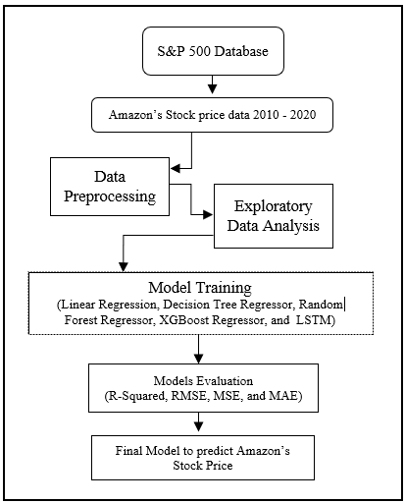
overview Architecture
Extracted data using Web Scraping Technique.
In Data Preprocessing we checked for NULL values and Removed If exists.
In EDA we extracted insights from the data and analyze as well as visualize it.
The 5 Machine Learning Models were applied on the dataset to predict the Closing Price of the Stock and then created the Evaluation Metrics of this models.
Compared different models on the metrics values and estimated their performance on the data.

Slide 6
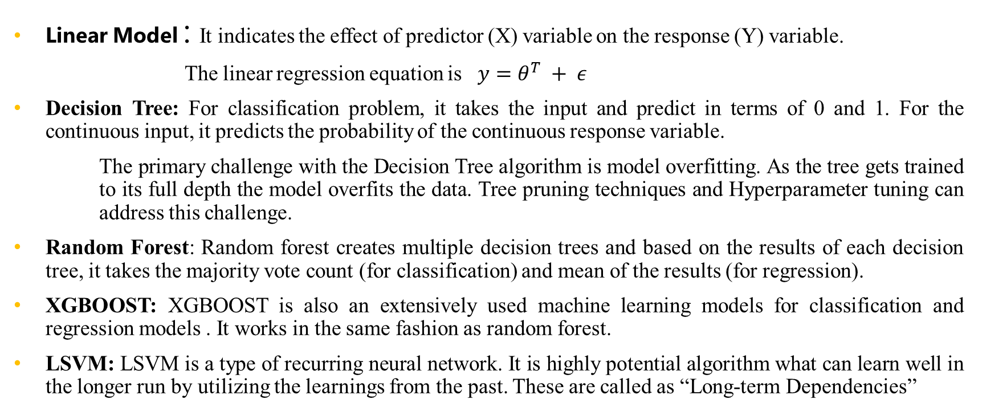
Description of Machine Learning Algorithms
Linear Model : It indicates the effect of predictor (X) variable on the response (Y) variable.
The linear regression equation is $y=θ^{T} + ε$
Decision Tree: For classification problem, it takes the input and predict in terms of 0 and 1. For the continuous input, it predicts the probability of the continuous response variable.
The primary challenge with the Decision Tree algorithm is model overfitting. As the tree gets trained to its full depth the model overfits the data. Tree pruning techniques and Hyperparameter tuning can address this challenge.
Random Forest: Random forest creates multiple decision trees and based on the results of each decision tree, it takes the majority vote count (for classification) and mean of the results (for regression).
XGBOOST: XGBOOST is also an extensively used machine learning models for classification and regression models . It works in the same fashion as random forest.
LSVM: LSVM is a type of recurring neural network. It is highly potential algorithm what can learn well in the longer run by utilizing the learnings from the past. These are called as “Long-term Dependencies”

Slide 7
Experimental Design
The data preprocessing in which null values have been checked and removed.
Exploratory data analysis to analyze the data.
5 different machine learning models to predict the close price of amazon stocks.
Evaluation Matrices of all the models.

Slide 8
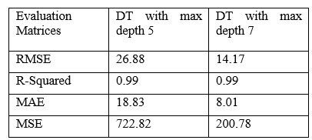
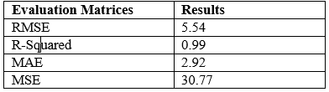
Results
Decision Tree
Linear Regression
The model indicates that the predictor variables Open, High, Low, Volume, Increase in Volume, and Increase in Adjusted Close is explaining 99% variability in Closing price (Y).
We found the Decision Tree Regressor is fitting the model and shows that 99% variability of response variable has been explained by the predictor variables.

Slide 9
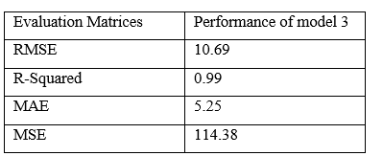
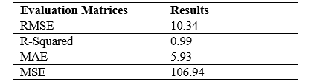
Results Continue..
XGBOOST
Random Forest
We executed the Decision Tree Regressor twice with two different types of values of max depth. We set the max depth to control the model overfitting.
XGBoost model reduced the mean squared error and root mean squared error significantly. The model also explains 99% variation in the data. The Absolute value is higher in the XGBoost model.

Slide 10
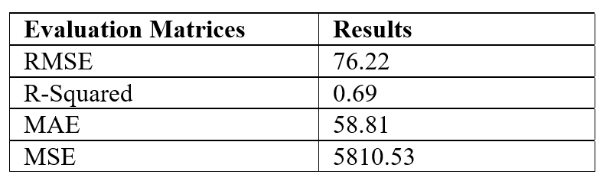
Results Continue..
Long-Short Term Memory
Based on the results of all the models, we can see the LSTM model is not performing well on the current data. The Linear regression model performed better than other four models as it is explaining the more variability than the other models; as well as it is giving less error rate against the regression line.

Slide 11
Conclusion
Stock Markets are the driving factor of an economy that impacts the companies and its market value. In this paper the machine and deep learning has been addressed to build a framework for Amazon investors to predict the future prices.
The amazon investors can get benefitted by making an appropriate decision regarding their investments. The study utilized the ten years of historical stock price data to predict the future price
Five different models have been built and compared based on their performance criteria. R-Squared, RMSE, MSE, and MAE have been used to evaluate the model performance.
We were optimistic about the performance of the LSTM model, but the model did not improve its performance.

Slide 12
Authors Contributions
Navjot Kaur: Student of Master of Science in Data Science at Michigan Technological University, Houghton MI, USA. Author Conrtributed in Experiment Design and Methods Specifications, wrote first draft of the document, implemented the XGBoost and Document review and editing.
Prathamesh Jadhav: Student of Master of Science in Data Science at Michigan Technological University, Houghton MI, USA. Author Conrtributed in investigating the regression methods and models, implemented the Decision Tree, Random Forest, and Linear Regression
Surya Ravula: Student of Master of Science in Data Science at Michigan Technological University, Houghton MI, USA. Author Conrtributed to introduce the topic, Implemented the data preprocessing, exploratory data analysis, and implementation of LSTM model.

